Slide 1


SC1015 MINI-PROJECT
ECDS Group 5
Xie Xiaomei U2430937E
Xie Xiaotian U2430437J

Slide 2
Table of contents
>
Problem Formulation
>
Data Cleaning
>
Exploratory Data Analysis
>
Data Preparation
>
Machine Learning
>
Conclusion and Insights

Slide 3

Problem Formulation
Real-world problem
MORE THAN
800 million
PEOPLE ARE AFFECTED GLOBALLY
IN THE U.S. ALONE, UNDIAGNOSED DIABETES COSTS OVER
400 billion
USD ANNUALLY

Slide 4
Problem Formulation
Real-world problem
Problem
Despite medical advancements, millions—especially in underserved communities—don’t get screened in time.
Traditional healthcare systems lack the capacity to follow up with every at-risk individual.

Slide 5
Problem Formulation
Practical Motivation
But....
We realise that by identifying high-risk individuals sooner, we can:
Prevent complications through timely treatment
Reduce emergency care and long-term costs

Slide 6
Problem Formulation
Data-Science Problem
Data Science
Problem
Can we use machine learning to predict diabetes risk using routine clinical and lifestyle data?

Slide 7
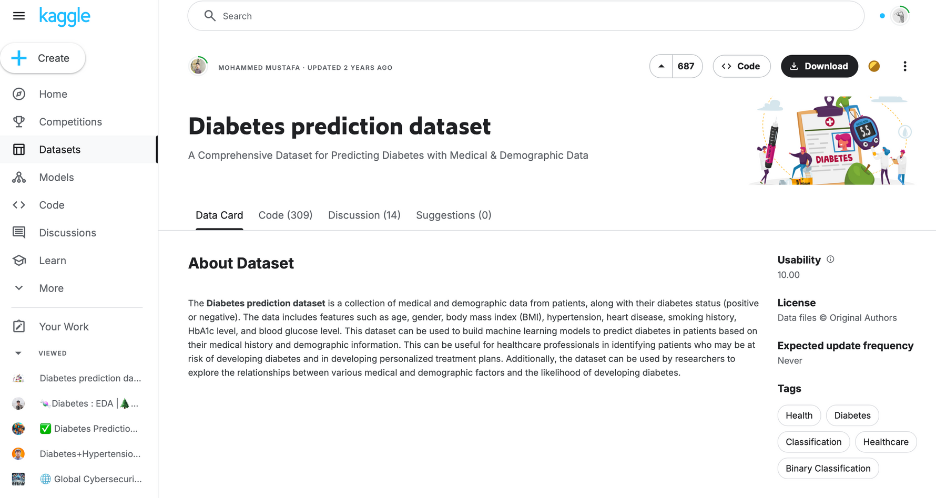
Problem Formulation
Dataset
Our Dataset

Slide 8
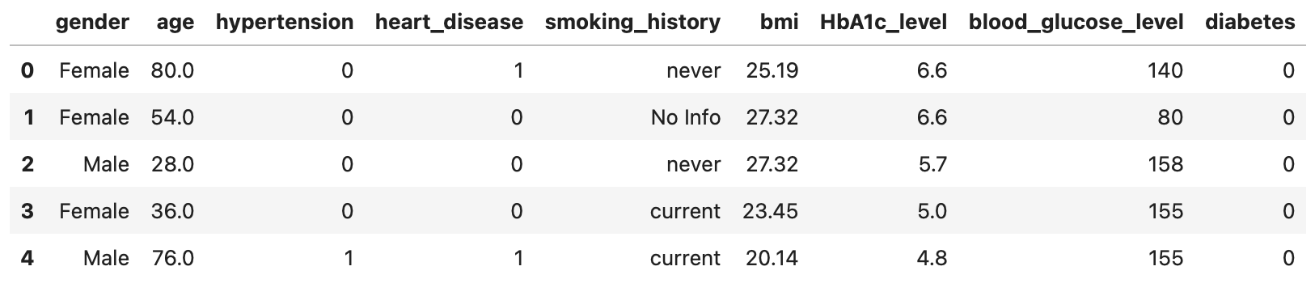
Problem Formulation
Dataset
Our Dataset

Slide 9
Data Cleaning
Overview
Steps
>
Drop duplicate rows
>
Choose relevant columns
>
Remove rows that had “Other” for gender
>
One-hot encode categorical data (LEARNT!!)

Slide 10
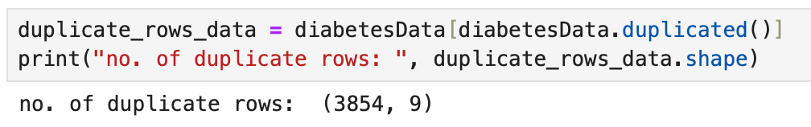
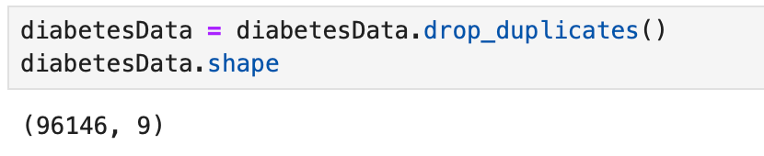
Data Cleaning
Drop Duplicates Rows
Number of duplicate rows
Avoid Data Bias: Duplicate entries can artificially inflate the importance of certain data points.
Better Evaluation Metrics: Duplicates can inflate performance metrics (like accuracy or recall) by repeating easy-to-predict instances.
(rows, columns) after dropping duplicate rows

Slide 11
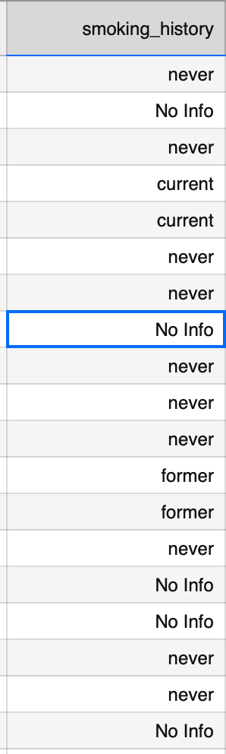
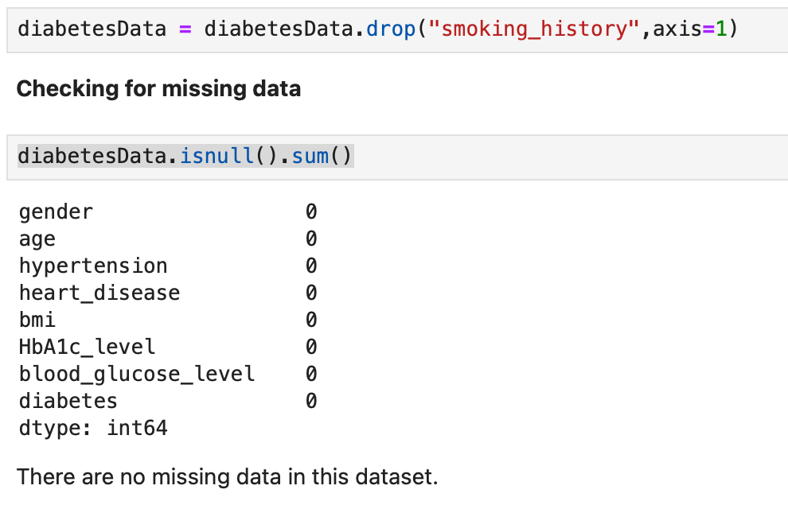

Data Cleaning
Choose Columns
Drop smoking_history

Slide 12


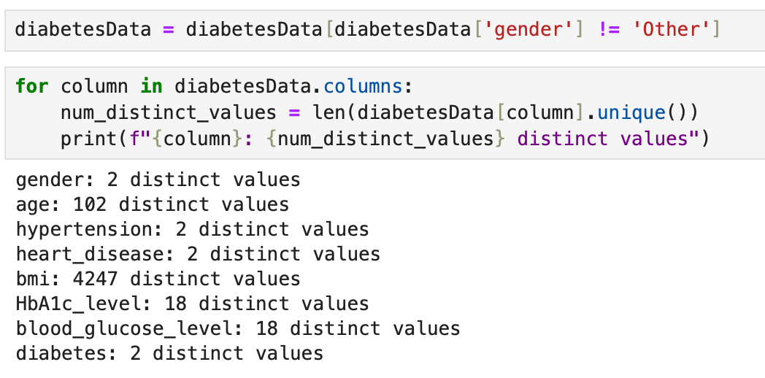
Data Cleaning
Remove Rows in “Gender”
Remove rows with gender entries labeled 'Other'

Slide 13
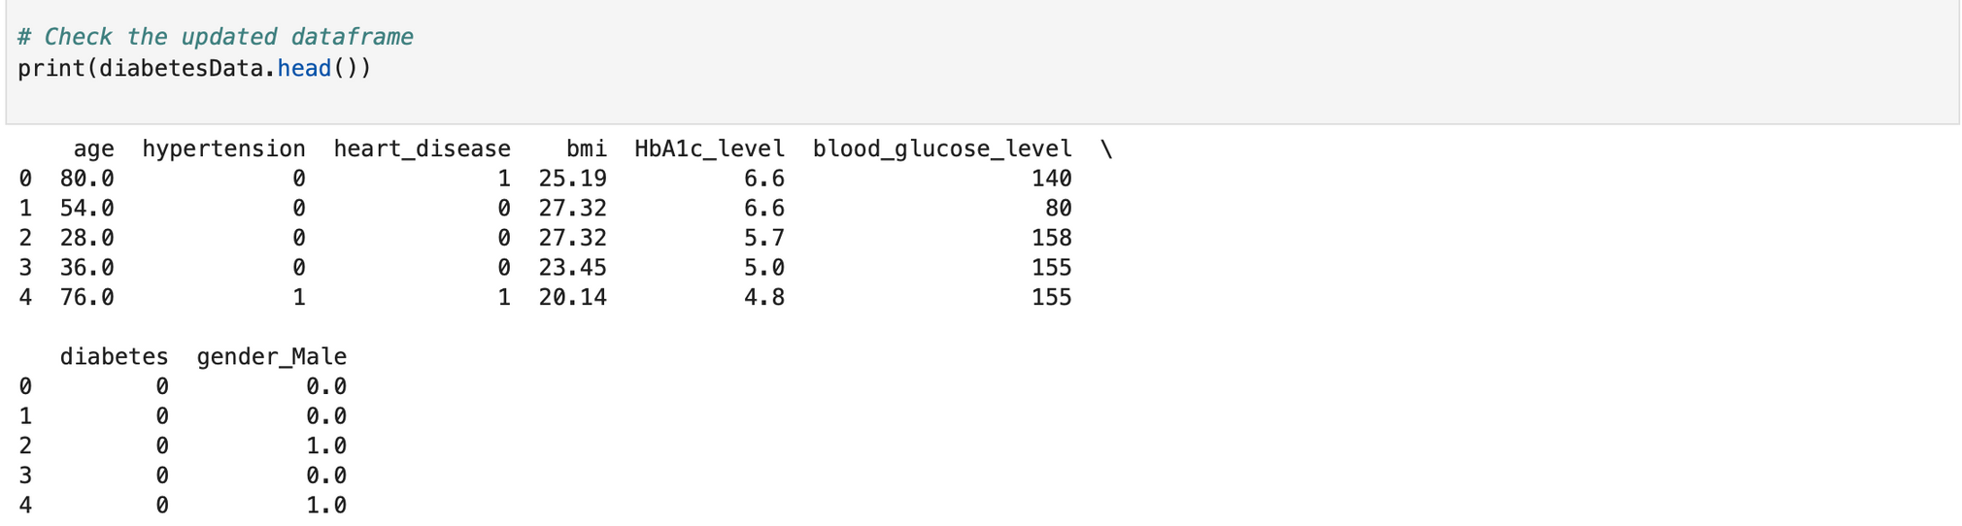
Data Cleaning
One-Hot encoding
One-hot encode categorical variable
Dataframe with encoded categorical variables
One-hot encoding is a technique used to convert categorical variables into a numerical format without introducing unintended ordinal relationships
Newly Learnt!!!

Slide 14
EDA
Overview
Exploratory Data Analysis
>
Initial Observations
>
Univariate Data Analysis
>
Bivariate Data Analysis
>
Multivariate Data Analysis

Slide 15
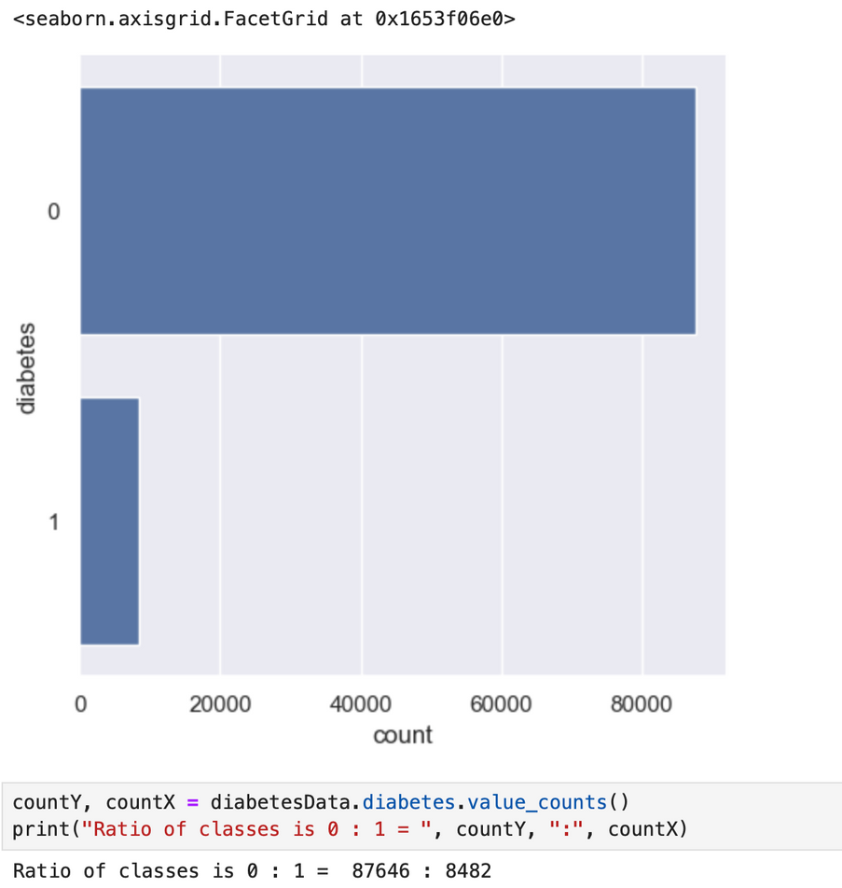
EDA
Initial Observations
ONLY
8.8%
of patients have diabetes—highlighting class imbalance, hence we might require resampling.
Because of this
Plan to use metrics like F1-score , precision and recall, not just accuracy.

Slide 16
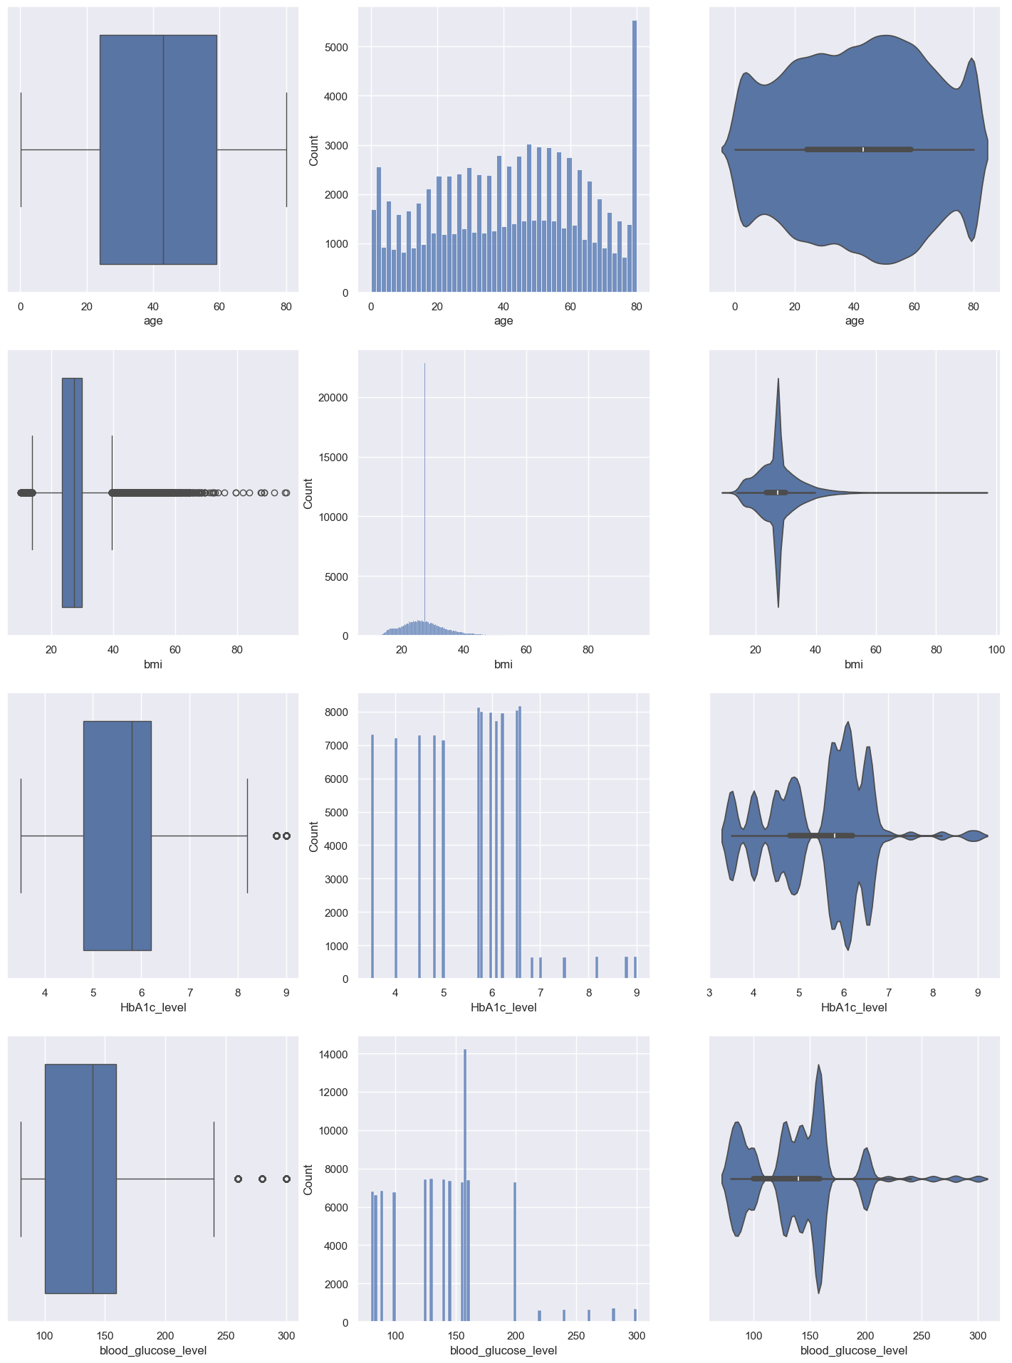
EDA
Univariate Data Analysis
Age
Age is symmetrically distributed around 40, suggesting a broad age range.

Slide 17
EDA
Univariate Data Analysis
BMI
BMI is right-skewed, with many individuals in the overweight or obese range—and some extreme outliers.

Slide 18
EDA
Univariate Data Analysis
HbA1c_level
HbA1c, a measure of long-term blood sugar, ranges mostly between 5.5 and 6.5, but a heavy tail beyond 8

Slide 19
EDA
Univariate Data Analysis
Blood glucose level
Blood glucose peaks around 150 mg/dL but includes high outliers.

Slide 20
EDA
Univariate Data Analysis
Outliers?
In medical data, outliers reflect important clinical conditions
Removing such values could reduce the model’s ability to detect severe case.

Slide 21
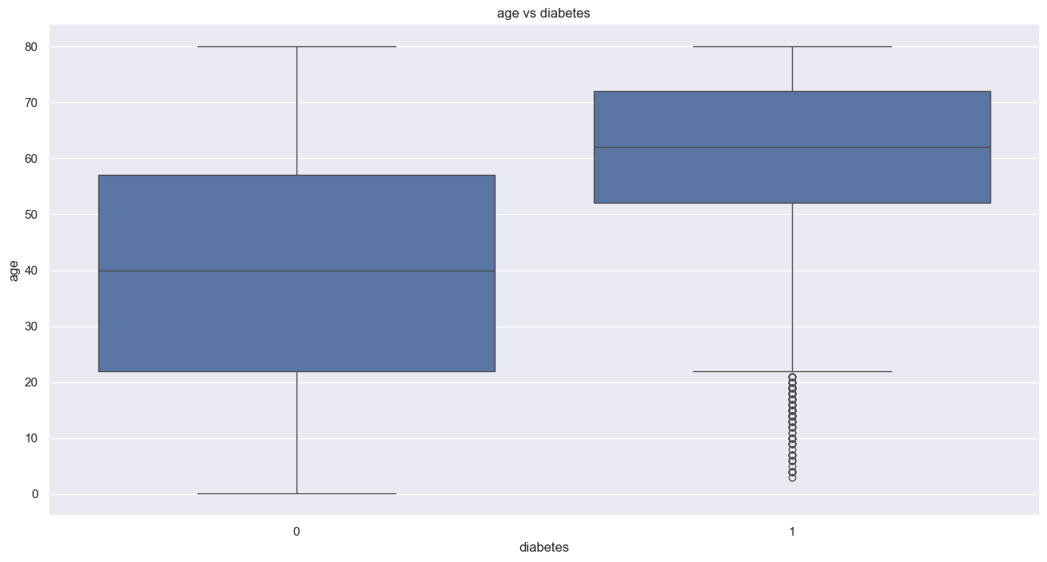
EDA
Bivariate Data Analysis
Age vs Diabetes
The median age for diabetics is 63, while for non-diabetics, it’s around 40.

Slide 22
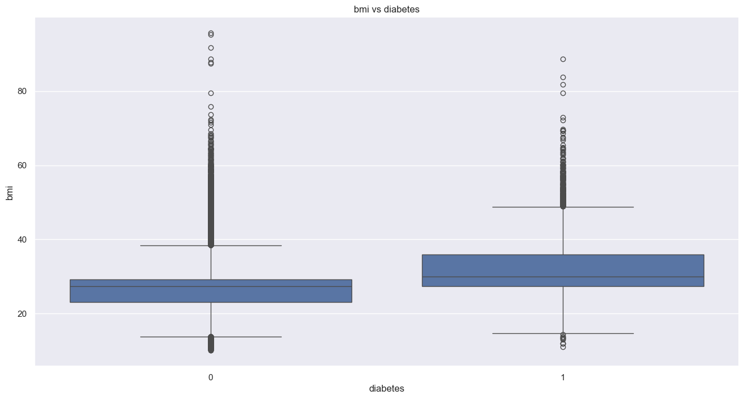
EDA
Bivariate Data Analysis
BMI vs Diabetes
Diabetics tend to have higher BMI, but there’s a lot of overlap between groups.

Slide 23
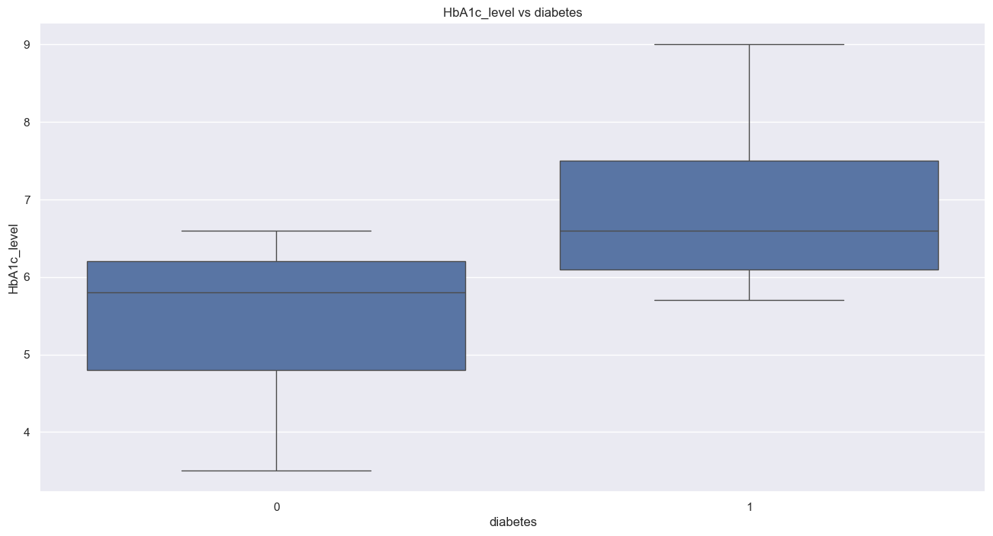
EDA
Bivariate Data Analysis
HbA1c vs Diabetes
Diabetics usually score well above 6.5

Slide 24
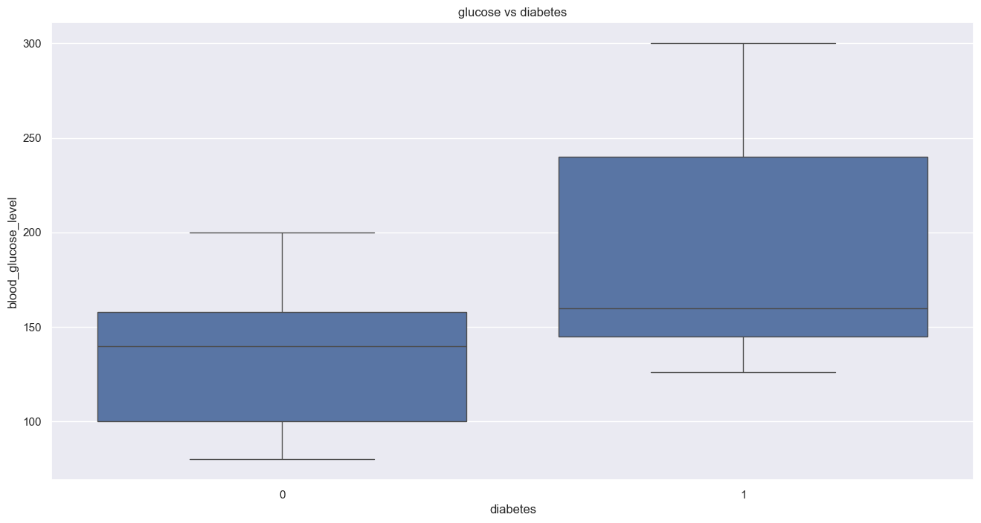
EDA
Bivariate Data Analysis
Blood Glucose vs Diabetes
Diabetics tend to have higher and more variable levels.

Slide 25
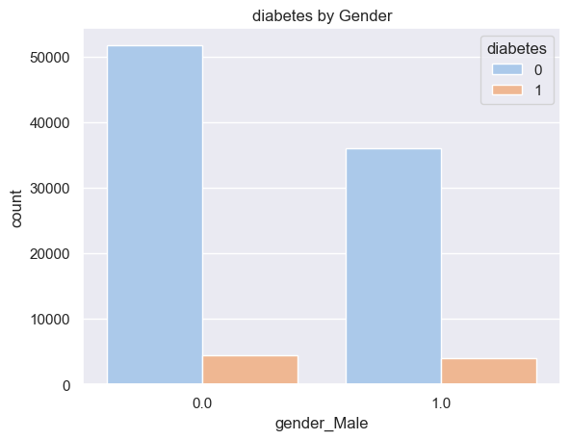
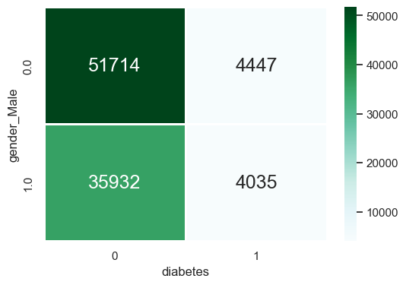
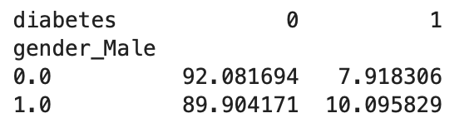
EDA
Bivariate Data Analysis
Gender vs Diabetes
The diabetes rate is higher among males—10.1% compared to 7.9% for females.

Slide 26
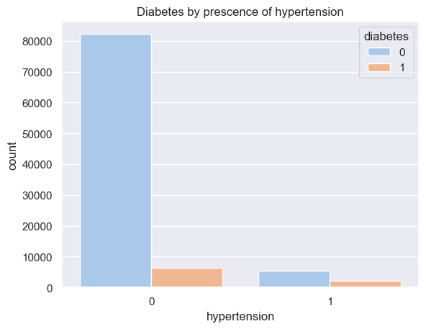
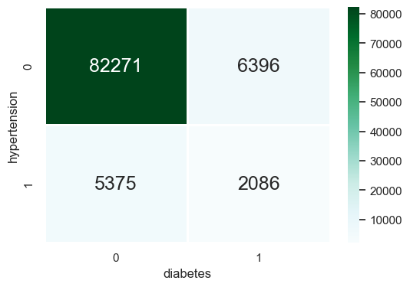
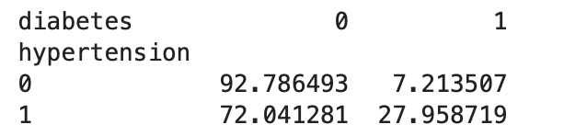
EDA
Bivariate Data Analysis
Hypertension vs Diabetes
Even though most diabetics don't have hypertension, having hypertension appears to significantly increase diabetes risk.

Slide 27
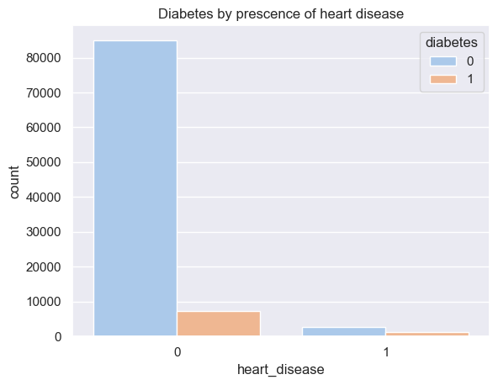
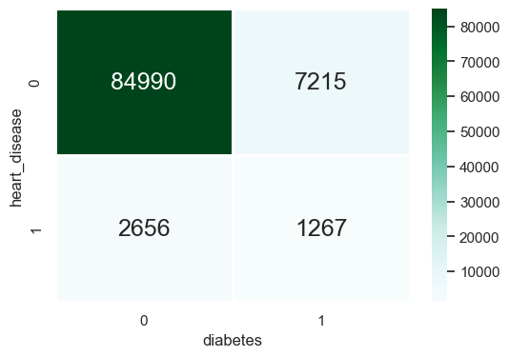
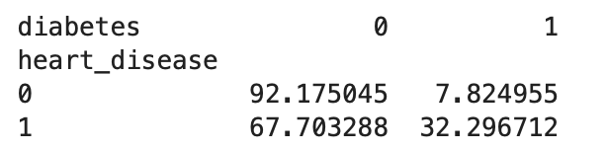
EDA
Bivariate Data Analysis
Heart disease vs Diabetes
Those with heart disease show a 32.3% diabetes rate, versus 7.8% for others

Slide 28
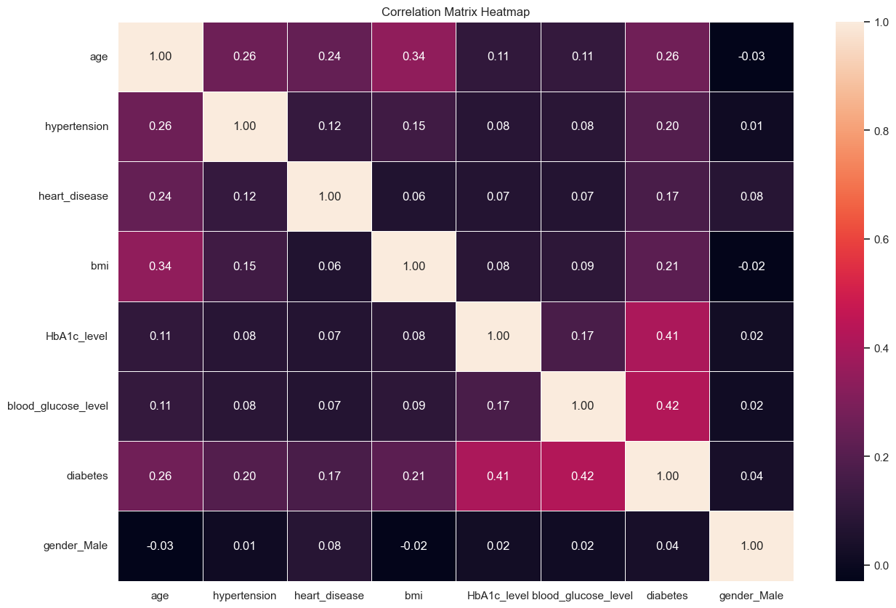
EDA
Multivariate Data Analysis
Correlation Matrix

Slide 29
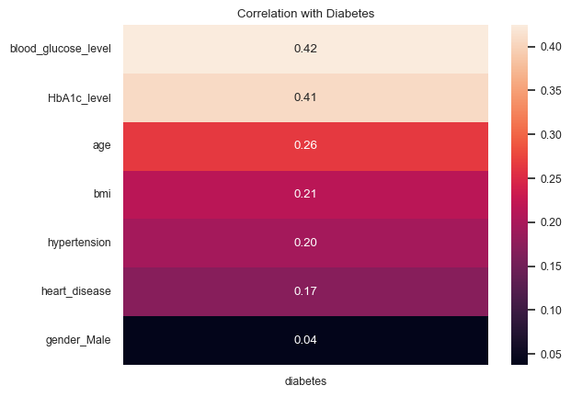
EDA
Multivariate Data Analysis
Correlation Ranking

Slide 30
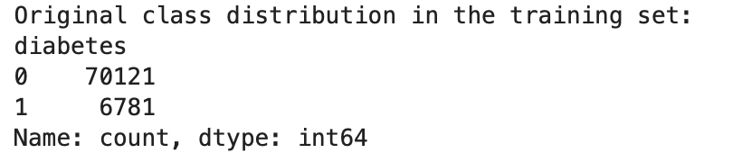
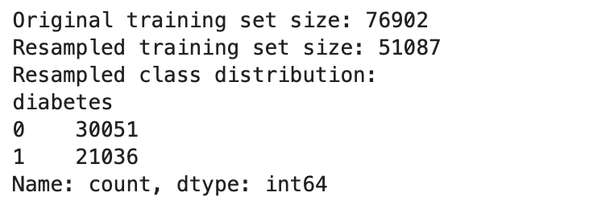
Data Preparation
Resampling
Resampling of train data
>
SMOTE (Synthetic Minority Over-sampling Technique)
>
Random Undersampler
Newly Learnt!!!

Slide 31
Machine Learning
Overview
Machine Learning
Multi-variate Decision Tree
Logistic Regression
Random Forest (default hyperparameter)
Random Forest ( tuned hyperparameter)
course material
newly learnt
newly learnt
newly learnt

Slide 32
Machine Learning
Evaluation metrics
Recall
important as missing actual diabetes cases could delay critical care
Evaluation Metrics with Clinical Context
Precision
important as false alarms waste resources and cause patient stress
F1 score
balances recall and precision

Slide 33
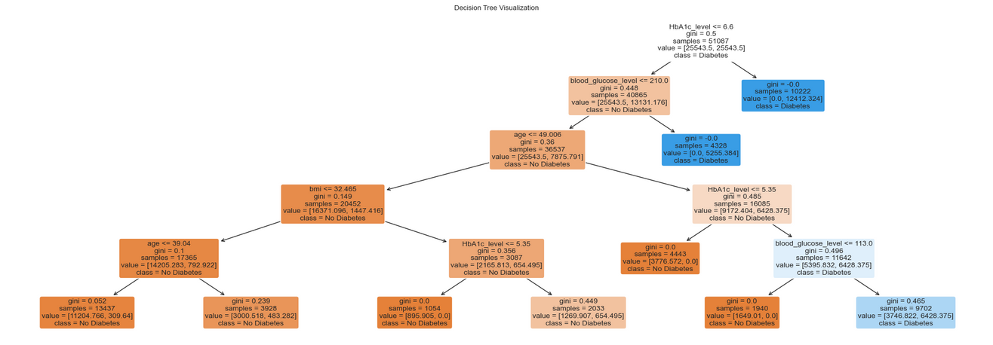
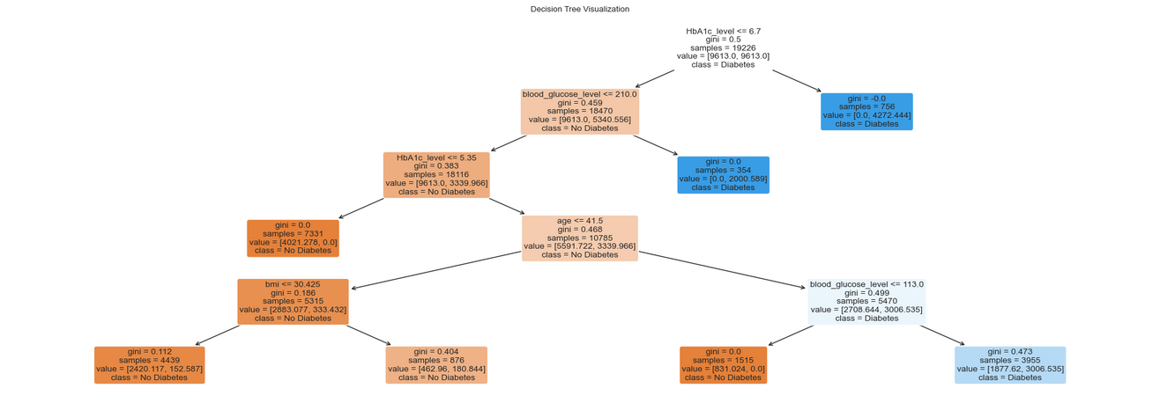
Machine Learning
Classification Tree
Multi-variate Classification Tree
Train Data
Test Data

Slide 34
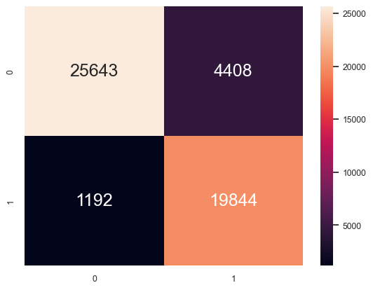
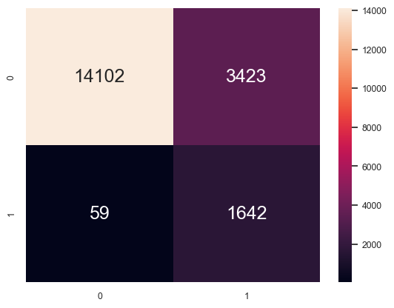
Machine Learning
Classification Tree
Multi-variate Classification Tree
Train Data
Test Data
Accuracy : 0.890
TPR Train : 0.943
TNR Train : 0.853
FPR Train : 0.147
FNR Train : 0.057
Precision : 0.818
Recall : 0.943
F1 Score : 0.876
Accuracy : 0.819
TPR Test : 0.965
TNR Test : 0.805
FPR Test : 0.195
FNR Test : 0.035
Precision : 0.324
Recall : 0.965
F1 Score : 0.485

Slide 35
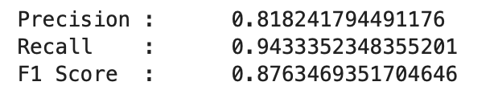
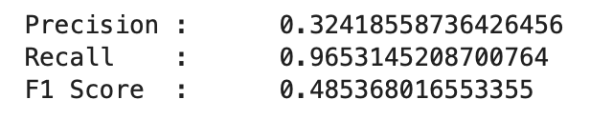
Machine Learning
Classification Tree
Multi-variate Classification Tree
Train Data
Test Data
It flagged nearly 70 percent of the patients as diabetic even though they are not
Floods the system with false alarms, predicting diabetes in many healthy patients

Slide 36
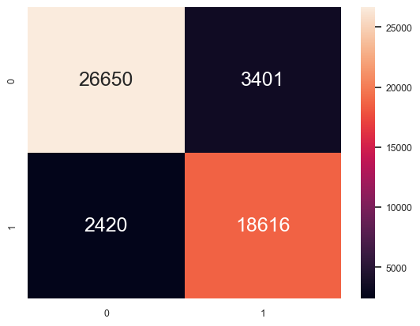
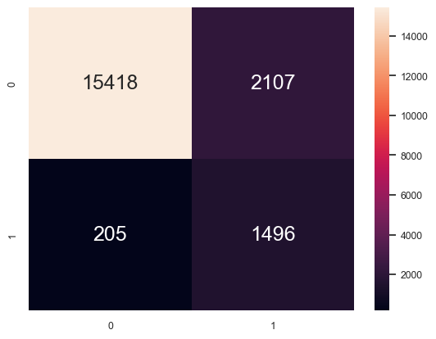
Machine Learning
Logistic Regression
Logistic Regression
Train Data
Test Data
Accuracy : 0.886
TPR Train : 0.885
TNR Train : 0.887
FPR Train : 0.113
FNR Train : 0.115
Precision : 0.846
Recall : 0.885
F1 Score : 0.865
Accuracy : 0.880
TPR Test : 0.879
TNR Test : 0.880
FPR Test : 0.120
FNR Test : 0.121
Precision : 0.415
Recall : 0.879
F1 Score : 0.564

Slide 37
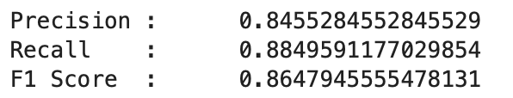
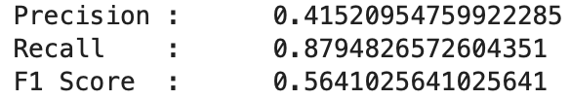
Machine Learning
Logistic Regression
Logistic Regression
Train Data
Test Data
It flagged nearly 60 percent of the patients as diabetic even though they are not
Floods the system with false alarms, predicting diabetes in many healthy patients

Slide 38
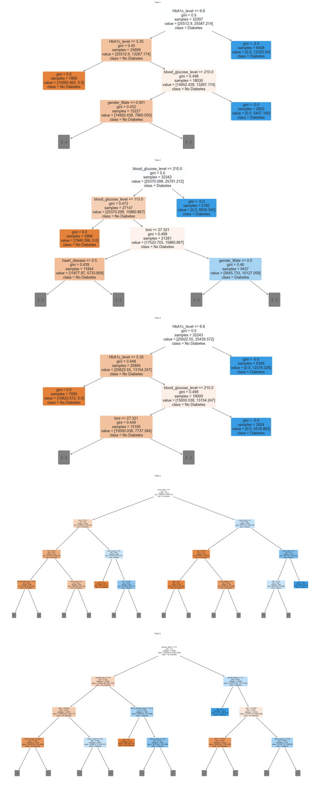
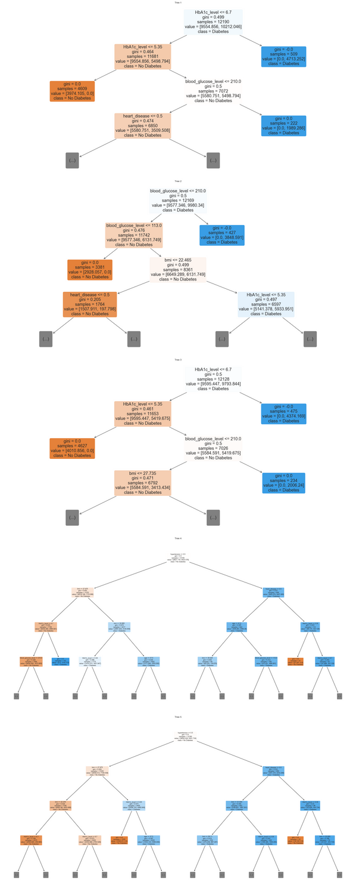
Machine Learning
Random Forest
Random Forest
(before tuning)
Train Data
Test Data

Slide 39
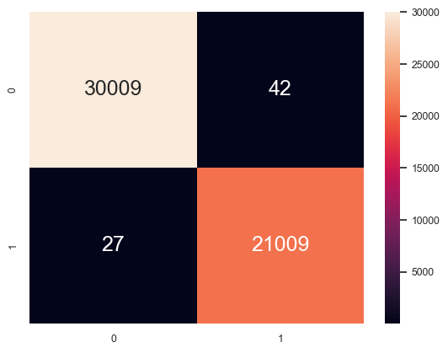
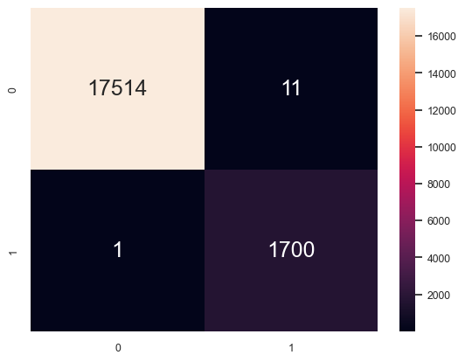
Machine Learning
Random Forest
Random Forest
(before tuning)
Train Data
Test Data
Accuracy : 0.999
TPR Train : 0.999
TNR Train : 0.999
FPR Train : 0.001
FNR Train : 0.001
Precision : 0.998
Recall : 0.999
F1 Score : 0.998
Accuracy : 0.999
TPR Test : 0.999
TNR Test : 0.999
FPR Test : 0.001
FNR Test : 0.001
Precision : 0.994
Recall : 0.999
F1 Score : 0.996

Slide 40
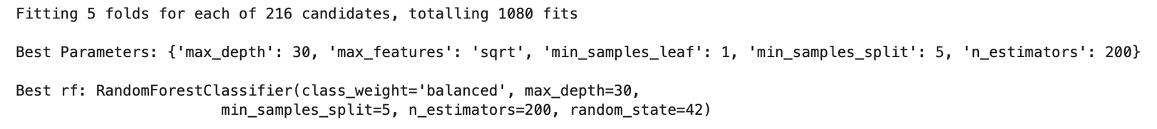
Machine Learning
GridSearchCV
GridSearchCV
Max Depth = 30
hyperparameter tuning
tested 216 different parameter combinations, using cross-validation to find the most reliable setting
Min Samples Split = 5

Slide 41
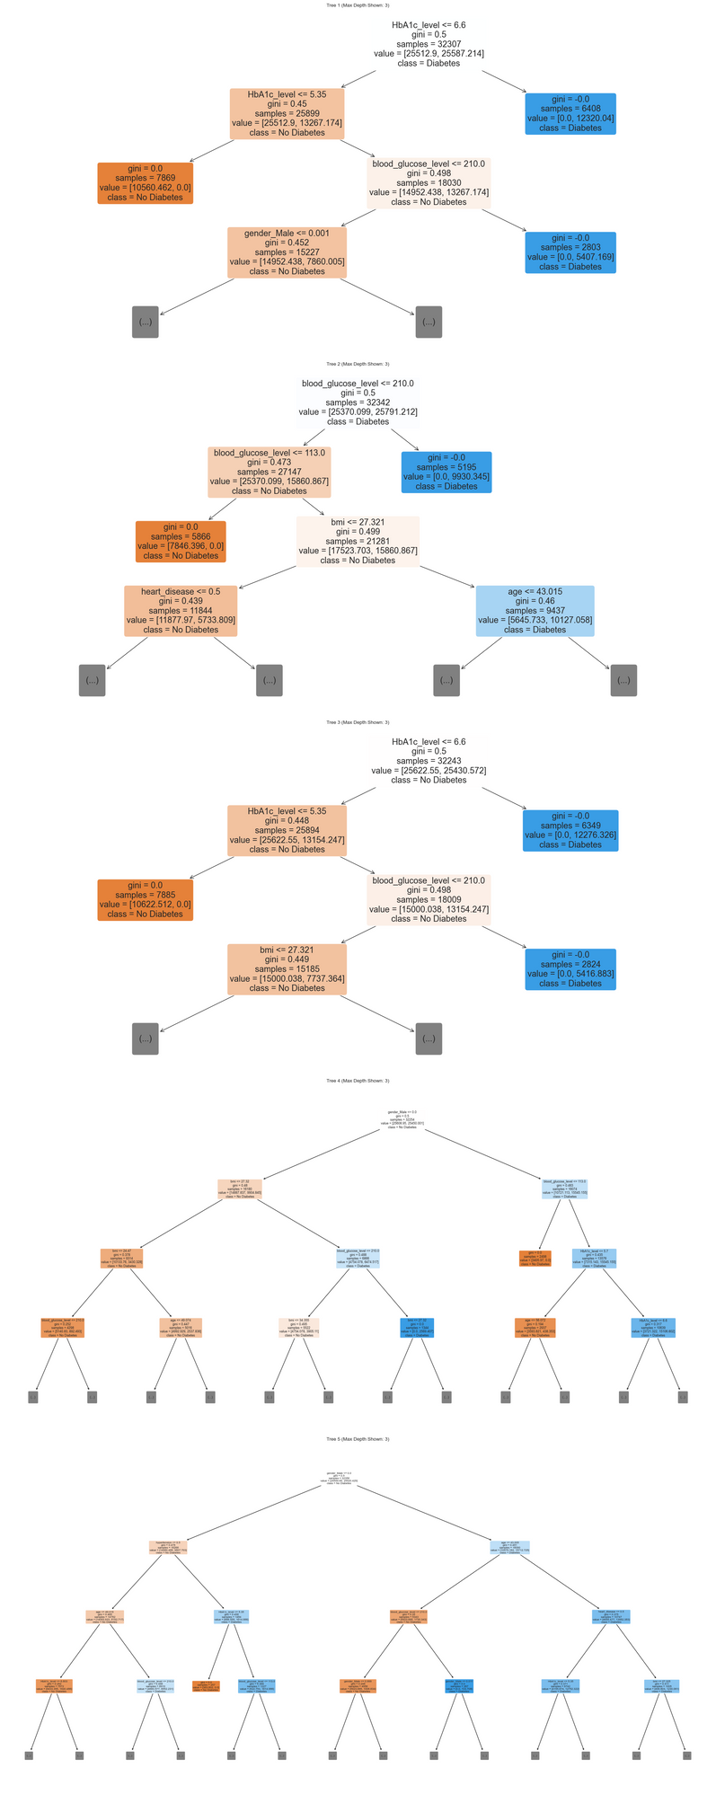
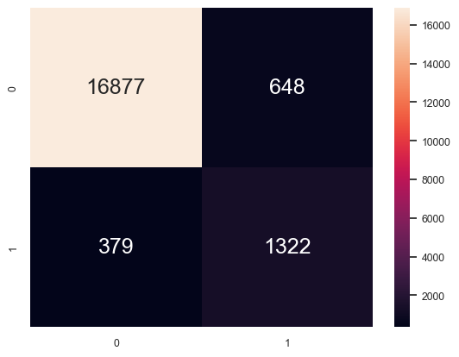
Machine Learning
Random Forest
Random Forest
(after tuning)
Test Data
Accuracy : 0.947
TPR Test : 0.777
TNR Test : 0.963
FPR Test : 0.037
FNR Test : 0.223
Precision : 0.671
Recall : 0.777
F1 Score : 0.720

Slide 42
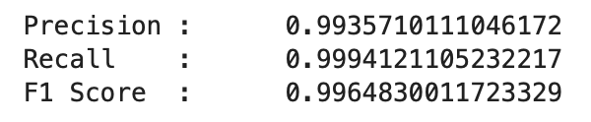
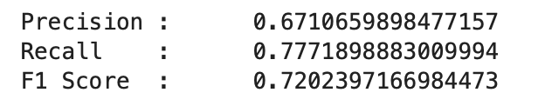
Machine Learning
Random Forest
Random Forest Comparison
Before Tuning
After Tuning
Precision: 0.994 to 0.671
Recall: 0.999 to 0.777
F1 Score: 0.996 to 0.720

Slide 43
Machine Learning
Random Forest
Random Forest Comparison
These numbers might seem worse, but they are actually more trustworthy
It catches slightly fewer true cases but is more reliable when it does flag someone as high-risk.

Slide 44
Conclusion
Overview
Conclusion

Slide 45
Conclusion
Outcome
Outcome and
Solution Effectiveness
Captures around 3 out of 4 actual diabetes cases
Keep false alarms at clinically manageable levels
Using our ML, healthcare providers can use it to predict whether a patient is at risk of diabetes and allow more efficient use of resources in healthcare sectors

Slide 46
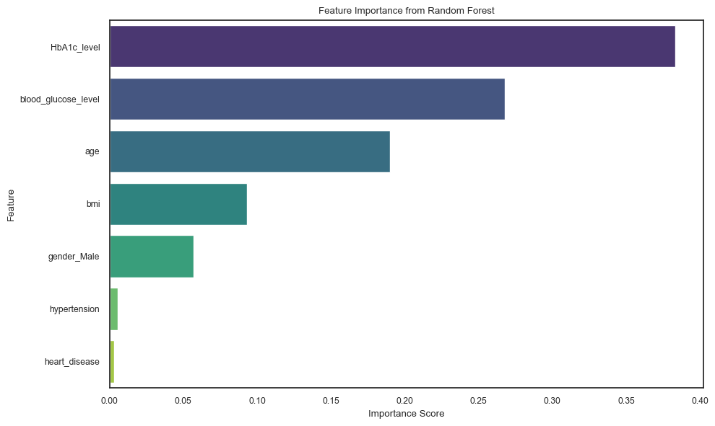
Conclusion
Outcome

Slide 47
Conclusion
Insights
Data Driven Insights
Always include HbA1c and glucose tests as they are the most important predictors
Adjust thresholds based on age
Less emphasis on conditions like Hypertension and Heart Disease

Slide 48
Conclusion
Insights
Surprising finding
Hypertension and heart disease added almost no predictive value according to the ranking
BUT
It could be a result of class imbalance within these features. Our dataset contained a very small proportion of individuals with hypertension and heart disease

Slide 49
Conclusion
Actions
Prioritize HbA1c testing for all patients over the age of 40, regardless of other risk factors
Actionable
Confirmatory testing should be focused on cases where HbA1c exceeds 5.7 and blood glucose is over 100
Recommendations
Confirmatory testing should be focused on patients aged 50+ with BMI greater than 25

Slide 50
THANK YOU
Xie Xiaomei
Data Cleaning
Univariate Data Analysis (categorical data)
Bivariate Data Analysis (categorical data)
Resampling
Machine Learning (Multivariate Classification Tree, Random Forest)
Xie Xiaotian
Data Cleaning
Univariate Data Analysis (numerical data)
Bivariate Data Analysis (numerical data)
Multivariate Data Analysis
Machine Learning (Random Forest, Logistic Regression, Hyperparameter Tuning)

